Slide 1
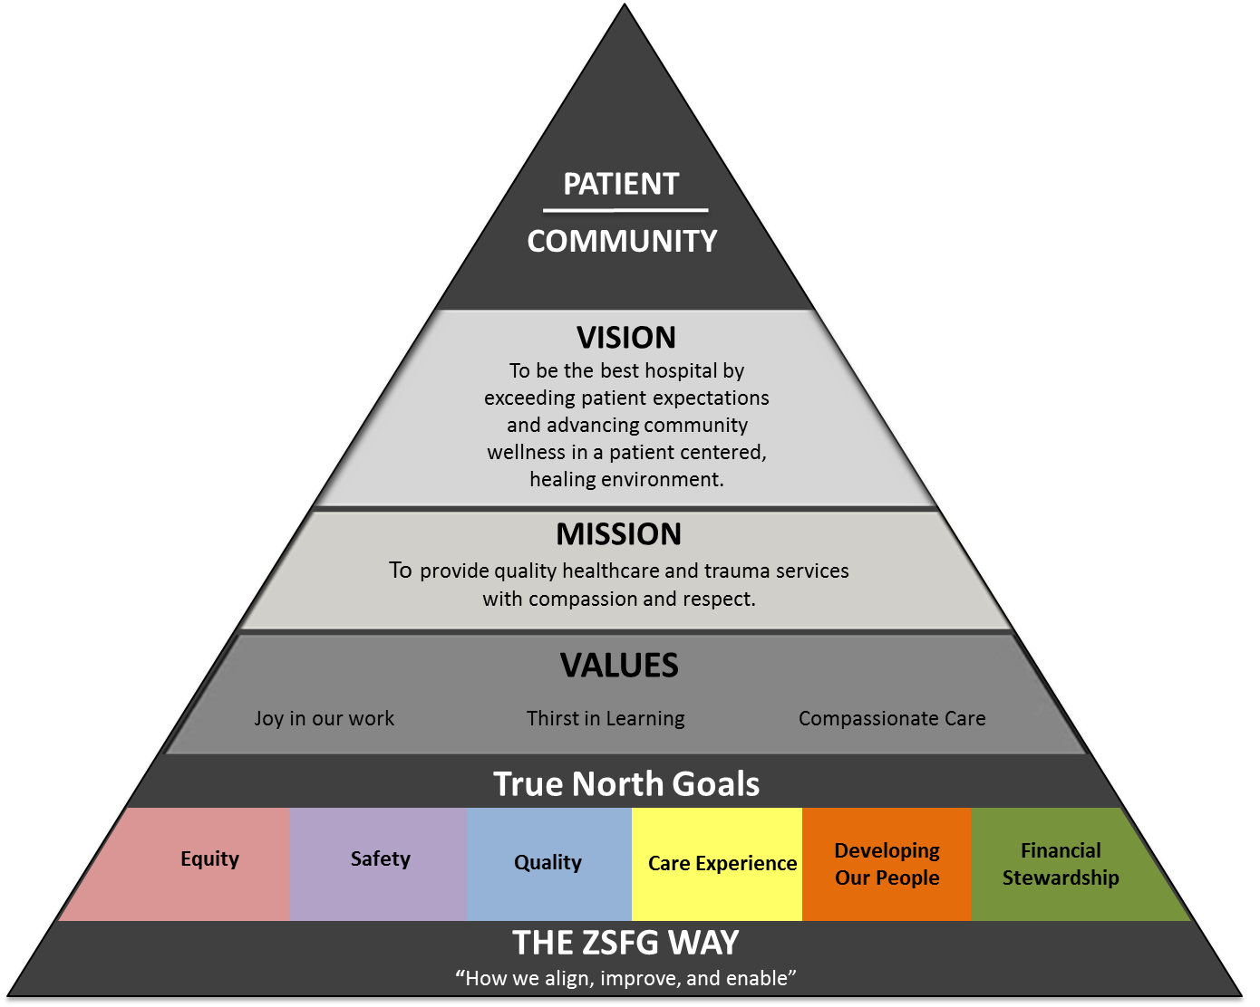
TRUE NORTH
Notes:
True North is the unwavering commitment to achieving our goals. Our True North is defined by our mission, vision, values, tactics and metrics that represent the direction we are heading in terms of being a health care organization of choice for our patients and staff.
In FY1617, we have added a new true north goal: Equity.
How do we know we’re heading in the right direction? We utilize those tools to plan, do, study and adjust (PDSA). There is evidence of our team of staff doing this everyday at ZSFG.

